Slide 1
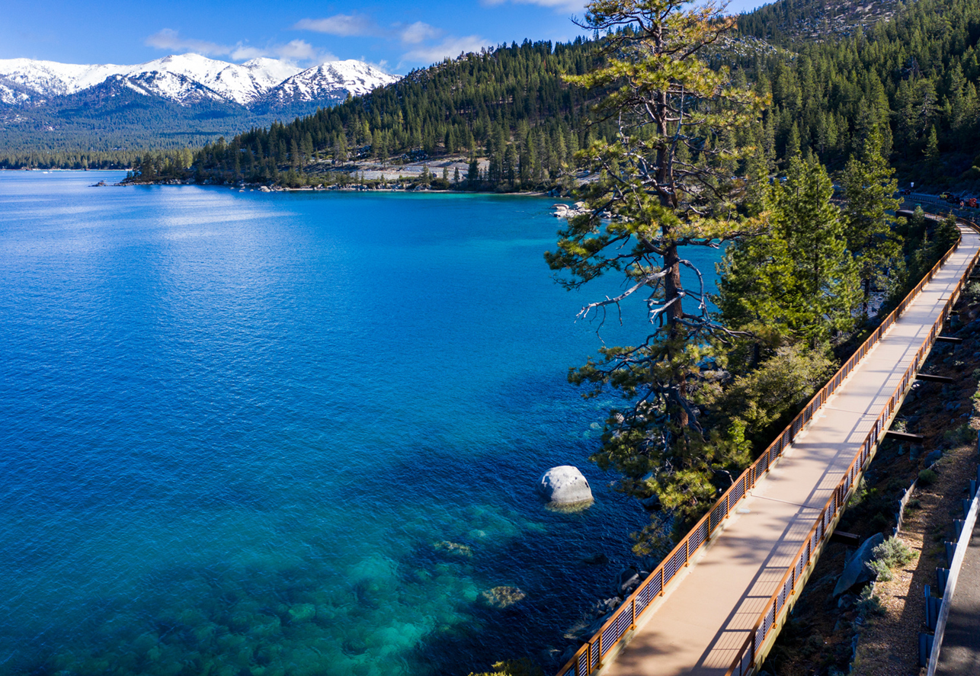
State Route 28
Nevada Transportation Conference
May 14, 2025
Tara Styer, Capital Program Manager- Tahoe Transportation District

Slide 2
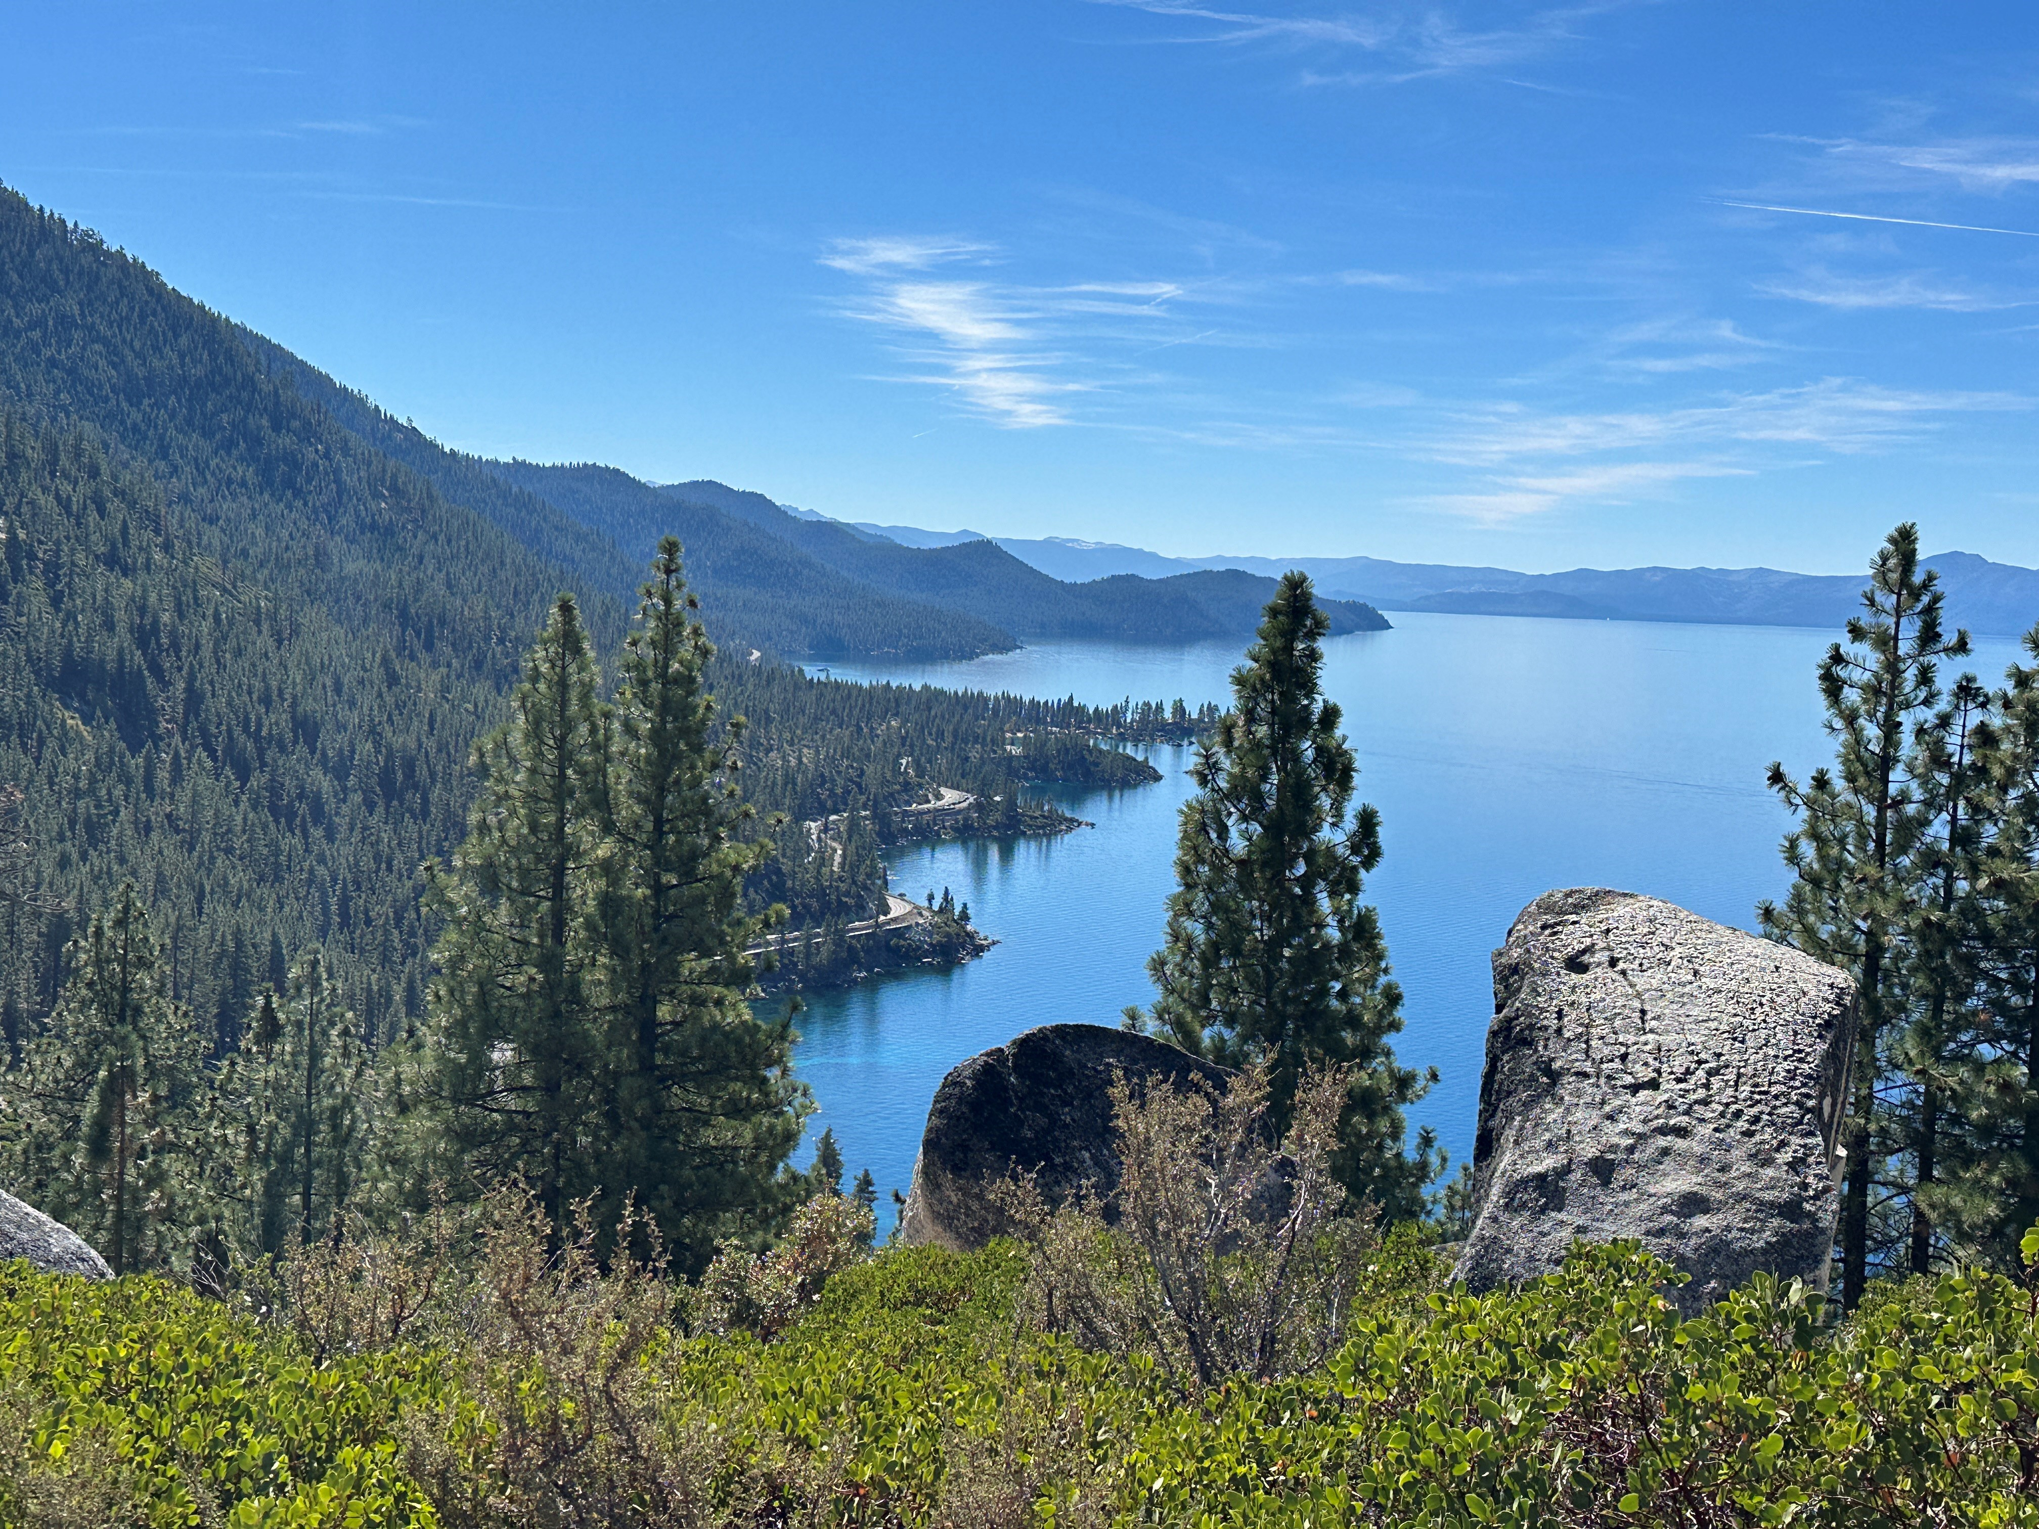
Agenda
About Tahoe Transportation District (TTD)
SR 28 Corridor Management Plan
Interlocal Agreement
Park Tahoe
SR 28 Projects
North Parking Lot
Sand Harbor to Thunderbird Cove
Thunderbird Cove to Secret Harbor
Spooner Mobility Hub & Aquatic Invasive Species (SMH/AIS) Inspection Station
Adaptative Management

Slide 3
About TTD
Bi-State Compact
In 1969, California and Nevada legislators agreed to a unique Compact for sharing Lake Tahoe resources/responsibilities. The two states and the U.S. Congress amended the Compact in 1980, with public law 96-551, which also established the Tahoe Transportation District (TTD).
TTD is responsible for facilitating and implementing safe, environmentally positive, multi-modal transportation plans, programs and projects for the Lake Tahoe Basin, including transit operations and parking management.

Slide 4
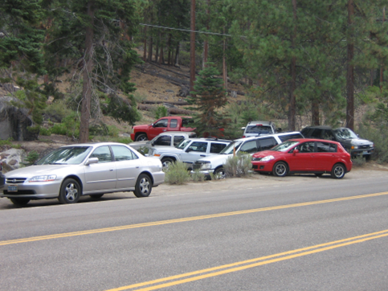
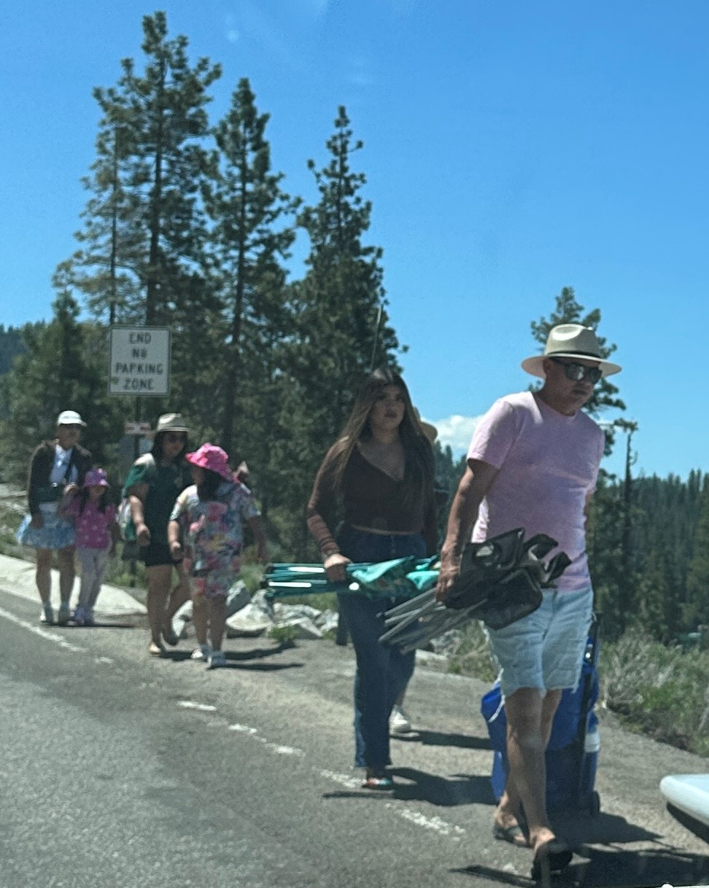
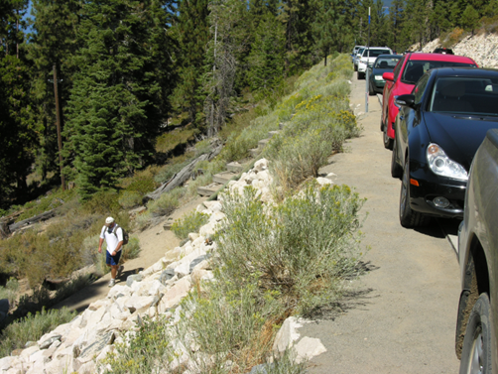
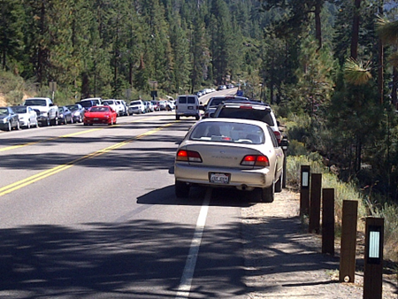
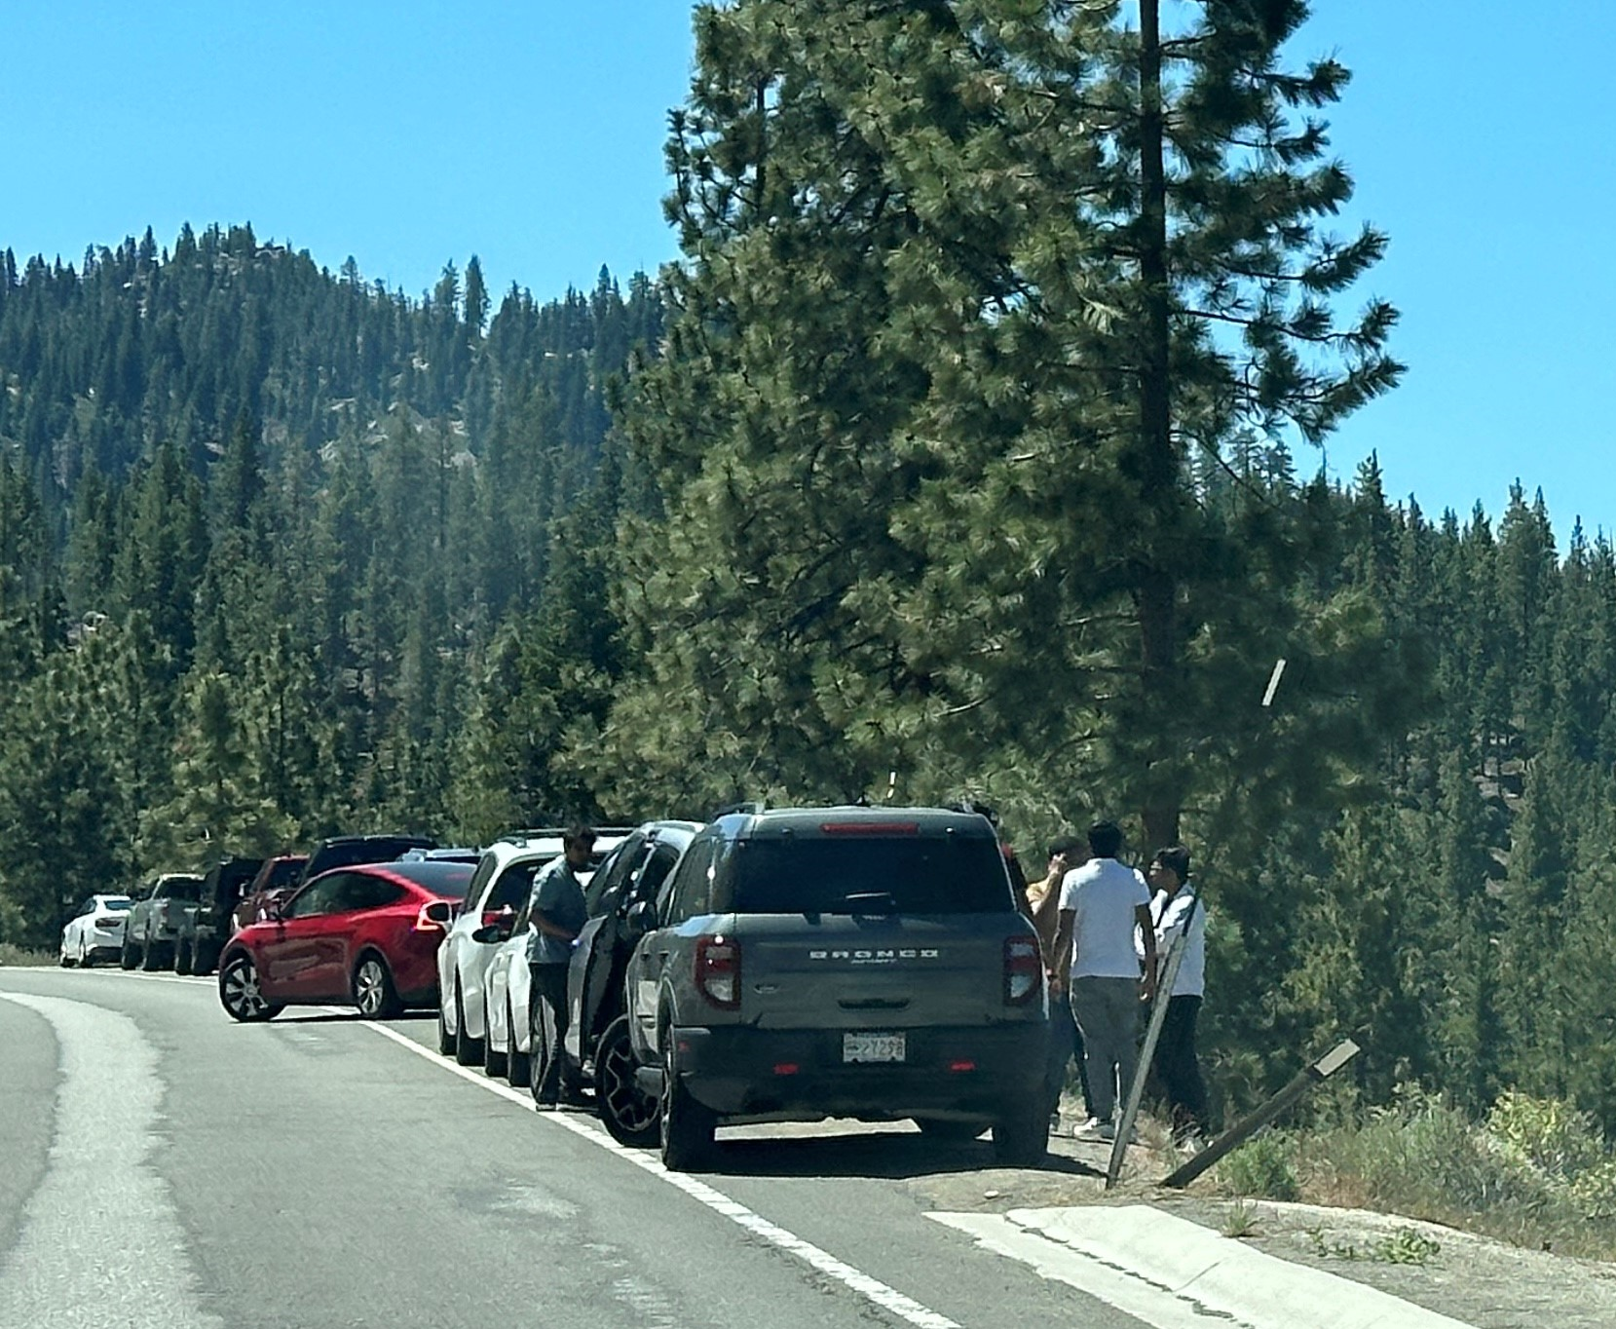
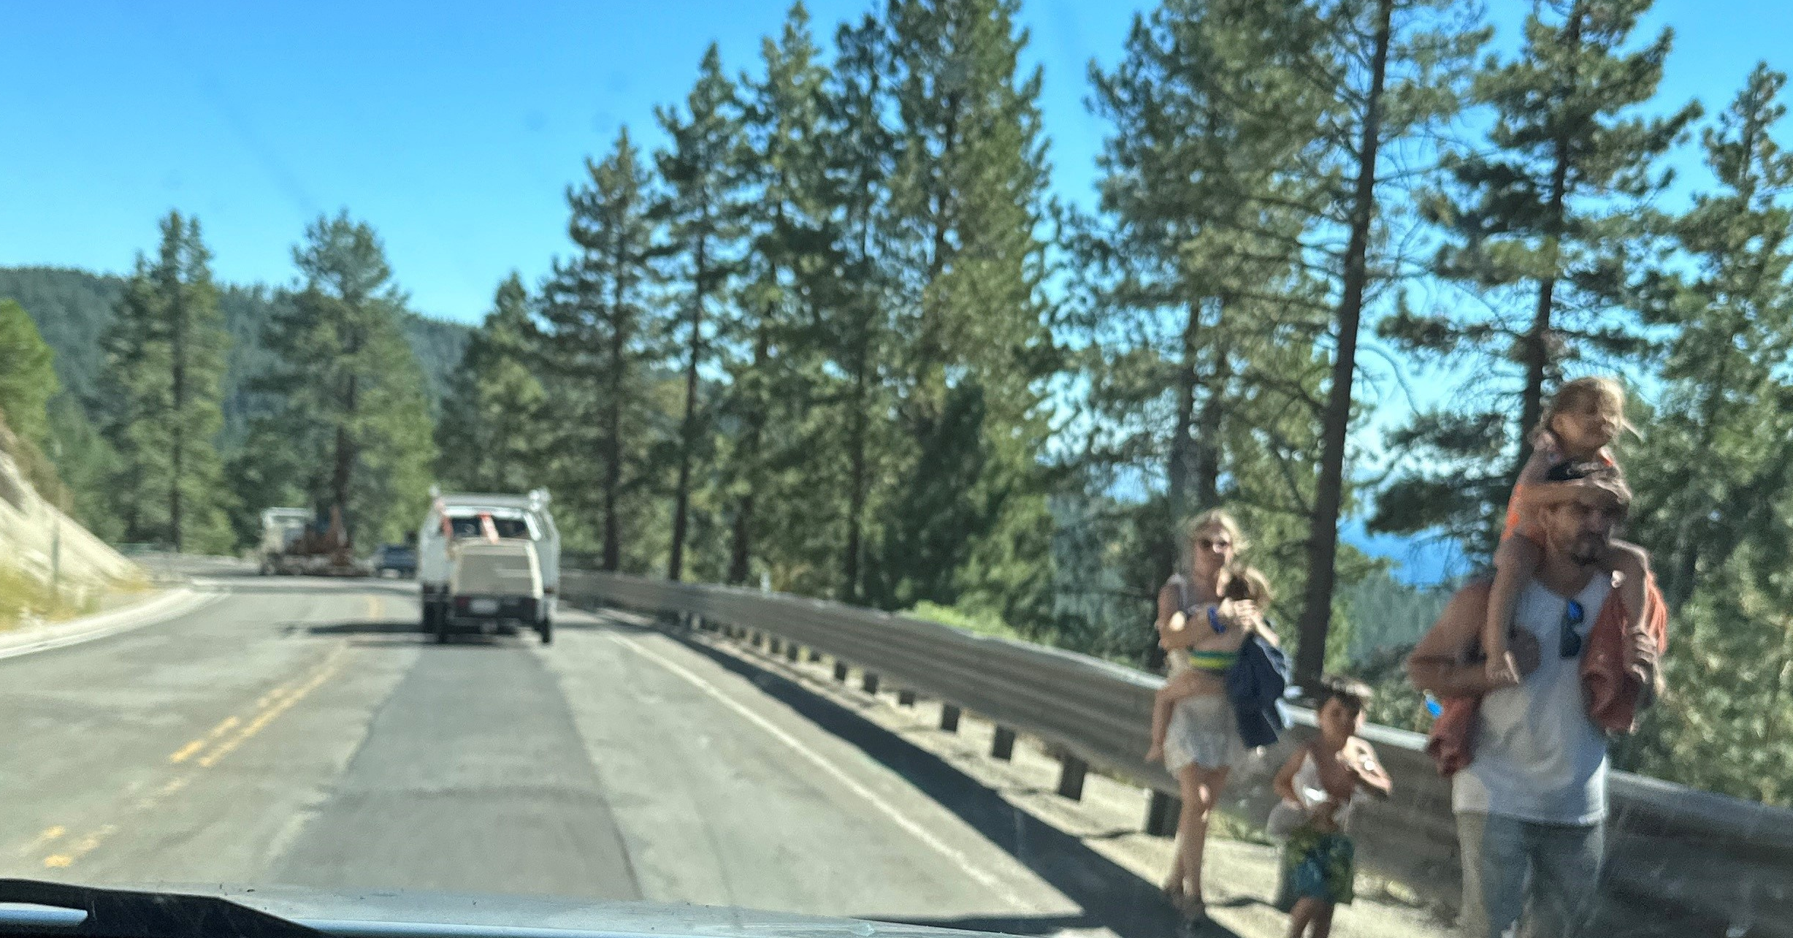
SR 28 Corridor
The Problem
www.tahoetransportation.org

Slide 5
SR 28 Corridor Management Plan The Solution
In 2013, 13 partner agencies came together to address the concerns along this section of highway and published the SR 28 National Scenic Byway Corridor Management Plan (CMP).
USFS completed the National Environmental Protection Act Environmental Analysis in 2019 for all proposed projects
CMP Goals:
Improve safety
Protect the Lake
Enhance the visitor experience
Expand multi-modal transportation choices
Promote economic vitality
13 partner
agencies came together...

Slide 6
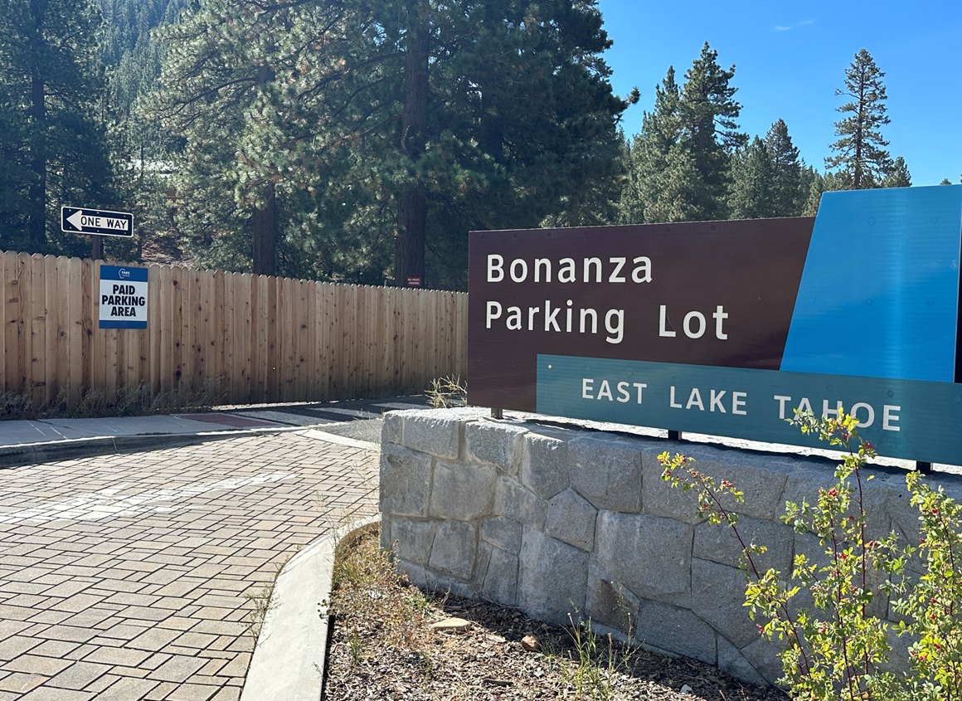
SR 28 Interlocal Agreement
Umbrella agreement that provides framework for operations and maintenance (O&M) of 10 agencies
Recognize missions of individual agencies
Provides platform for collaboration and partnership
Formation of a Corridor Management Team (CMT)
Establishes roles and responsibilities by project
Amendable agreement by impacted agencies
Living document referenced and improved by
partner agencies

Slide 7
Parking Management Plan – Park Tahoe
90 paid parking spaces: Four parking kiosks and pay-by-text functionality
Season: Paid parking March – November
Demand-Based Pricing: Parking rates increase mid-day, weekends, and holidays
Operations and Non-Compliance Programs:
Supported by vendors
Parking ambassadors issue notices of non-compliance
TTD administrative staff handle appeals, refunds, and questions/complaints
www.tahoetransportation.org
www.tahoetransportation.org/parking/

Slide 8
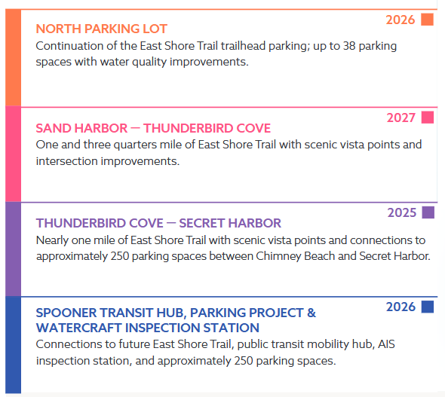
SR 28 Projects
SR 28 Projects Webpage

Slide 9
North Parking Lot
Challenge
200 shoulder-parked vehicles contribute to nearly 600 people per day walking on the highway during peak summer season
Solutions
Phase I (completed 2019) relocated approximately 90 shoulder-parked vehicles
Phase II will relocate approximately 38 vehicles to off-highway parking
Shared-use path will connect parking to East Shore Trail
Formalize the southbound transit stop at Lakeshore Blvd.
Expand the No Parking Zone north through the commercial area
Water quality improvements
Project Status
Design: To be completed fall 2025
Construction: Summer 2026
www.tahoetransportation.org

Slide 10
North Parking Lot
www.tahoetransportation.org

Slide 11
Sand Harbor – Thunderbird Cove
Challenge
348 shoulder-parked vehicles and nearly 1,000 people per day walking on the highway during peak summer season
Solutions
Construct approximately two miles of East Shore Trail from Sand Harbor to Thunderbird Cove
Relocate shoulder-parked vehicles to designated lots
Provide vista points and interpretative signage
Connect shared-use path to Sand Harbor and authorized shoreline access trails
Extend No Parking Zone
Project Status
Design: To be completed winter 2025/2026
Construction: Late summer 2026 (dependent on federal funding)
www.tahoetransportation.org

Slide 12
Thunderbird Cove – Secret Harbor
Challenge
348 shoulder-parked vehicles and nearly 1,000 people per day walking on the highway during peak summer season
Solutions
Relocate approximately 250 highway-parked vehicles to off-highway parking spaces at Chimney Beach and Secret Harbor
Pedestrian actuated crossing at Chimney Beach
Add one mile of East Shore Trail from Thunderbird Cove to Secret Harbor
Add transit stop and visitor amenities, including vista points
Extend No Parking Zone
Project Status
Design: To be completed fall 2025
Construction: Chimney Beach constructed by USFS in 2024; trail and Secret Harbor in summer 2026 (dependent on federal funding)
www.tahoetransportation.org

Slide 13
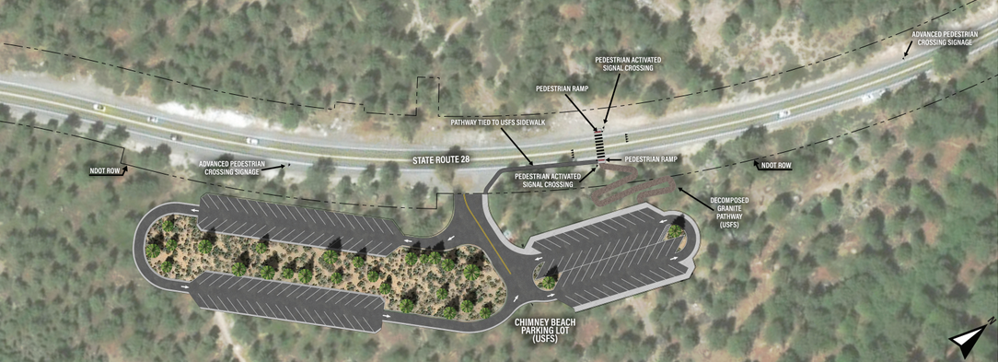
Thunderbird Cove – Secret Harbor
Chimney Beach Parking
www.tahoetransportation.org

Slide 14
Thunderbird Cove – Secret Harbor
Secret Harbor Parking and East Shore Trail
www.tahoetransportation.org

Slide 15
Spooner Mobility Hub & Aquatic Inspection Station (SMH/AIS)
Challenge
Access to the current AIS inspection station is unsafe and TRPA is seeking a permanent location. There is also a need to provide a park-n-ride/transit stop at the south end of the SR 28 corridor.
Solutions
Develop a joint-use facility across from Spooner Lake State Park that includes:
Watercraft inspection station and small office space; improved boat circulation
Up to 250 parking spaces for transit and trail connections to Spooner Lake State Park and future East Shore Trail
Restooms, transit shelter, benches, and signage
Project Status
Design: To be completed summer/fall 2025
Construction: 2026
www.tahoetransportation.org

Slide 16
Spooner Mobility Hub & Aquatic Inspection Station
www.tahoetransportation.org

Slide 17
Adaptive Management
Amend the interlocal agreement to include new parking facilities and trail expansion
Continued monitoring metrics, parking rates, and non-compliance escalation rates
Explore parking technologies, including real-time digital message signs and optic-based solutions
Create a consistent and predictable parking experience for visitors
Pursue expanding TTD’s authority to enforce parking management (i.e., shoulder parking and across jurisdictional boundaries)

Slide 18
Questions?
www.instagram.com/tahoetransdistrict
www.facebook.com/TahoeTransportationDistrict/

